Slide 1
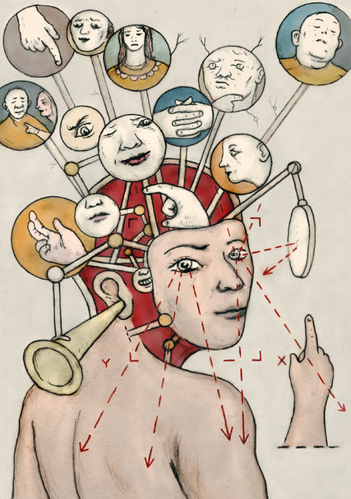
The Brain

Slide 2



What is it?
What does it do?
How does it work?

Slide 3
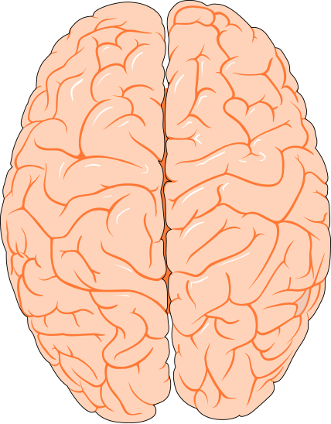
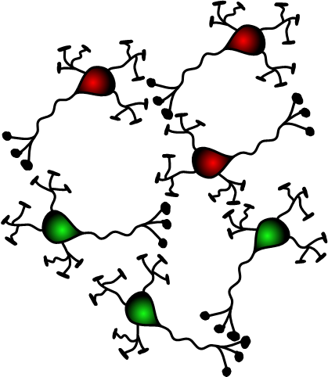
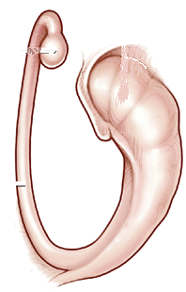
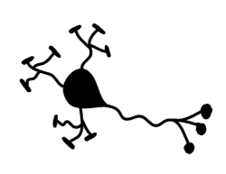
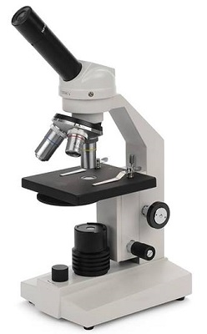

Depends on how you look at it…
Connections
Between
Cells
Brain
Structures
Insides
Of
Cells
Cells
Really
Small
Scale
Really
Big

Slide 4
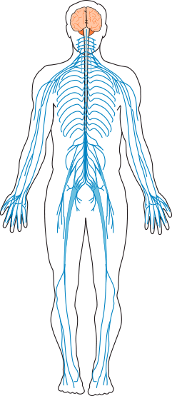
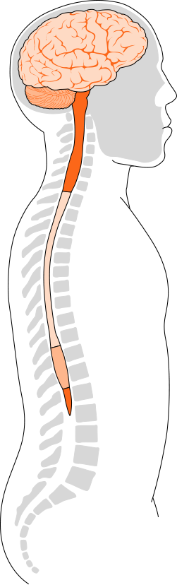
The Brain and Spinal Cord
The brain and spinal cord make up the central nervous system.
All other nerves in the body form the peripheral nervous system.
Illustrations © Williams & Wilkins. All rights reserved.
Notes:
The brain is the command center of the central nervous system; it controls virtually all functions of the body. The brain’s main communication channel to the rest of the body is the spinal cord. Nerves branch out from the spinal cord and send and receive information. All other nerves in the body form the peripheral nervous system.
Reference:
From the Brain Chemistry Teacher’s Guide activity, “The Brain.” Brain Chemistry Teacher’s Guide © Baylor College of Medicine (ISBN: 978-1-888997-45-3) was supported, in part, by funds from the National Institutes of Health, Science Education Partnership Award grant number R25RR13454, and the NIH Blueprint for Neuroscience Research Science Education Award, National Institute on Drug Abuse and NIH Office of the Director, grant number 5R25DA033006.
Image reference:
Illustrations © Williams & Wilkins. All rights reserved.

Slide 5
The Brain and Spinal Cord
Cerebral Hemispheres (top view)
Illustrations © Williams & Wilkins. All rights reserved.
Notes:
The brain of the average adult weighs about three pounds and fills over half the skull. Even though it is soft (like pudding), the brain can be divided into several regions, each with very specific functions.
The cerebrum, about 85% of the brain’s mass, sits above the brainstem and cerebellum. The surface of the cerebrum, known as the cerebral cortex, has bumps (gyri) and grooves (sulci). The cerebrum enables one to think, learn, reason, remember, feel sensations and emotions, and move muscles purposefully. It is comprised of two hemispheres (or halves), separated by a deep fissure.
The hemispheres are connected by a large bundle of nerve fibers known as the corpus callosum. They communicate with each other constantly. Even though the hemispheres may look the same, they are somewhat specialized for certain functions. For example, in most people, the ability to form words is a function that seems to be located within the left hemisphere, while the right hemisphere is better at processing spatial information. Different parts of each hemisphere handle specific functions, including hearing, vision, speech, memory, decision making and long-term planning.
The cerebellum sits at the back of the brainstem and is about the size of a tennis ball. It helps us maintain balance and posture, and coordinates our movements. The cerebellum also plays an important role in our ability to learn and remember new motor skills, such as riding a bike.
The limbic system is comprised of a number of interconnected brain regions, including areas within and under the cerebral hemispheres. It is involved in many emotions and motivations, especially those related to survival, such as anger, fear, and even the fight-or-flight response. The limbic system also plays an important role in feelings of pleasure, such as those experienced from eating and sex.
The brainstem connects directly with the spinal cord and is responsible for automatic functions of the body, including heartbeat, digestion, breathing, swallowing, coughing and sneezing. Automatic functions are present at birth and happen without thinking about them.
The brain’s main communication channel to the rest of the body is the spinal cord. Nerves branch out from the spinal cord and send and receive information.
Functions and abilities develop as the brain grows and matures. The human brain generally reaches close to 80% of its adult weight by the age of two or three, yet it continues to develop throughout adolescence and early adulthood. The region of the cerebral cortex responsible for judgment, organization and reasoning appears to be one of the last brain areas to reach maturity.
Reference:
From the Brain Chemistry Teacher’s Guide activity, “The Brain.” Brain Chemistry Teacher’s Guide © Baylor College of Medicine (ISBN: 978-1-888997-45-3) was supported, in part, by funds from the National Institutes of Health, Science Education Partnership Award grant number R25RR13454, and the NIH Blueprint for Neuroscience Research Science Education Award, National Institute on Drug Abuse and NIH Office of the Director, grant number 5R25DA033006.
Image reference:
Illustrations © Williams & Wilkins. All rights reserved.

Slide 6
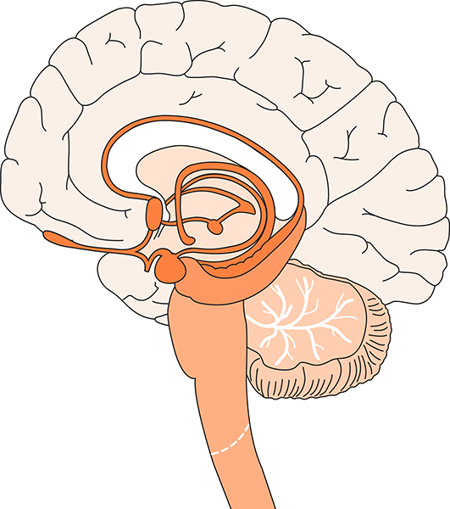
The Brain and Spinal Cord
Cerebrum
Cerebral Cortex
Corpus Callosum
Limbic System
Cerebral Hemispheres (top view)
Brain Stem
Cerebellum
Spinal Cord
Illustrations © Williams & Wilkins. All rights reserved.
Notes:
The brain of the average adult weighs about three pounds and fills over half the skull. Even though it is soft (like pudding), the brain can be divided into several regions, each with very specific functions.
The cerebrum, about 85% of the brain’s mass, sits above the brainstem and cerebellum. The surface of the cerebrum, known as the cerebral cortex, has bumps (gyri) and grooves (sulci). The cerebrum enables one to think, learn, reason, remember, feel sensations and emotions, and move muscles purposefully. It is comprised of two hemispheres (or halves), separated by a deep fissure.
The hemispheres are connected by a large bundle of nerve fibers known as the corpus callosum. They communicate with each other constantly. Even though the hemispheres may look the same, they are somewhat specialized for certain functions. For example, in most people, the ability to form words is a function that seems to be located within the left hemisphere, while the right hemisphere is better at processing spatial information. Different parts of each hemisphere handle specific functions, including hearing, vision, speech, memory, decision making and long-term planning.
The cerebellum sits at the back of the brainstem and is about the size of a tennis ball. It helps us maintain balance and posture, and coordinates our movements. The cerebellum also plays an important role in our ability to learn and remember new motor skills, such as riding a bike.
The limbic system is comprised of a number of interconnected brain regions, including areas within and under the cerebral hemispheres. It is involved in many emotions and motivations, especially those related to survival, such as anger, fear, and even the fight-or-flight response. The limbic system also plays an important role in feelings of pleasure, such as those experienced from eating and sex.
The brainstem connects directly with the spinal cord and is responsible for automatic functions of the body, including heartbeat, digestion, breathing, swallowing, coughing and sneezing. Automatic functions are present at birth and happen without thinking about them.
The brain’s main communication channel to the rest of the body is the spinal cord. Nerves branch out from the spinal cord and send and receive information.
Functions and abilities develop as the brain grows and matures. The human brain generally reaches close to 80% of its adult weight by the age of two or three, yet it continues to develop throughout adolescence and early adulthood. The region of the cerebral cortex responsible for judgment, organization and reasoning appears to be one of the last brain areas to reach maturity.
Reference:
From the Brain Chemistry Teacher’s Guide activity, “The Brain.” Brain Chemistry Teacher’s Guide © Baylor College of Medicine (ISBN: 978-1-888997-45-3) was supported, in part, by funds from the National Institutes of Health, Science Education Partnership Award grant number R25RR13454, and the NIH Blueprint for Neuroscience Research Science Education Award, National Institute on Drug Abuse and NIH Office of the Director, grant number 5R25DA033006.
Image reference:
Illustrations © Williams & Wilkins. All rights reserved.

Slide 7
Can we actually see brain structures?

Slide 8

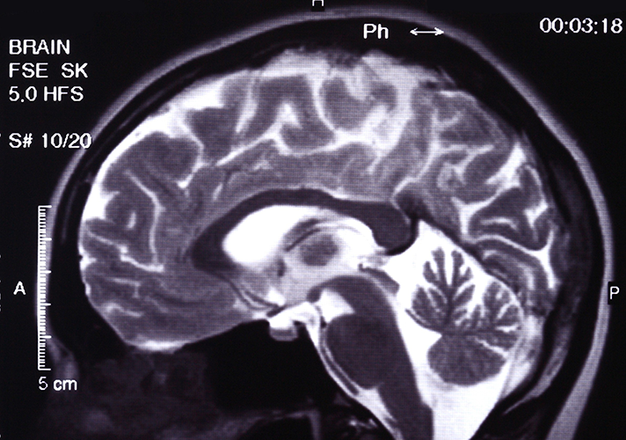
Brain Structure
This MRI of a normal brain reveals the different regions of the brain, each of which has specific functions.
Image © Mikhail Basov.
Notes:
In this MRI of a normal brain, the cerebrum, cerebellum, brain stem, and other regions of the brain are clearly visible.
Reference:
From the Brain Chemistry Teacher’s Guide activity, “The Brain.” Brain Chemistry Teacher’s Guide © Baylor College of Medicine (ISBN: 978-1-888997-45-3) was supported, in part, by funds from the National Institutes of Health, Science Education Partnership Award grant number R25RR13454, and the NIH Blueprint for Neuroscience Research Science Education Award, National Institute on Drug Abuse and NIH Office of the Director, grant number 5R25DA033006.
Image reference:
MRI © Mikhail Basov.

Slide 9
Does it grow?

Slide 10
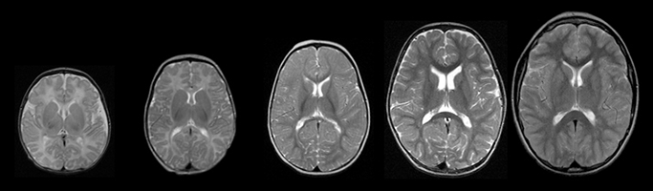
Brain Development
1
week
3
months
1
year
2
years
10
years
Connections
Between
Cells
Cells
Notes:
MRI images of brain development taken at ages 1 week, 3 months, 1 year, 2 years and 10 years.
Reference:
From the Brain Chemistry Teacher’s Guide activity, “The Brain.” Brain Chemistry Teacher’s Guide © Baylor College of Medicine (ISBN: 978-1-888997-45-3) was supported, in part, by funds from the National Institutes of Health, Science Education Partnership Award grant number R25RR13454, and the NIH Blueprint for Neuroscience Research Science Education Award, National Institute on Drug Abuse and NIH Office of the Director, grant number 5R25DA033006.
Image reference:
MRI courtesy of NIH from the MRI Study of Normal Brain Development project. http://pediatricmri.nih.gov/nihpd/info/index.html

Slide 11
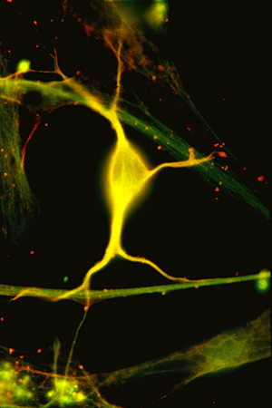
A Real Neuron
© Baylor College of Medicine\Robert S. McNeil.
Notes:
The human brain is the most complex structure in the known universe. Consisting of close to 100 billion nerve cells (and many times that number of supporting cells), the brain is the center of our thoughts and emotions. It receives and processes information from the world around us, directs our movements and controls automatic functions of our bodies. Amazingly, virtually all functions of the brain and the rest of the nervous system are based on communication among nerve cells, also known as neurons.
Reference:
From the Brain Chemistry Teacher’s Guide activity, “What Is a Neuron?” Brain Chemistry Teacher’s Guide © Baylor College of Medicine (ISBN: 978-1-888997-45-3) was supported, in part, by funds from the National Institutes of Health, Science Education Partnership Award grant number R25RR13454, and the NIH Blueprint for Neuroscience Research Science Education Award, National Institute on Drug Abuse and NIH Office of the Director, grant number 5R25DA033006.
Image reference:
Microscopic image © Baylor College of Medicine\Robert S. McNeil. http://www.neuralimages.org/

Slide 12
How do neurons
talk to each other?

Slide 13
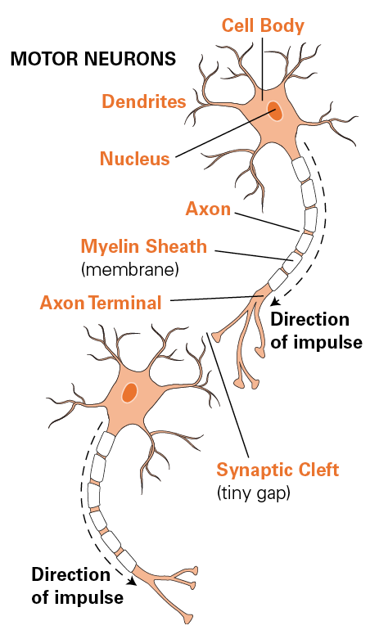
Typical Structure of Neurons
Flow
of
Information
Notes:
A typical neuron has an enlarged area, the cell body, which contains the nucleus. Neurons typically also have two types of specialized extensions that project away from the cell body. The branches on which information is received are known as dendrites. Each neuron usually has many dendrites. Each neuron usually also has a longer tail-like structure, or axon, which transmits information to other cells.
Axons can be branched at their tips. The axons of many kinds of neurons are surrounded by a fatty, segmented covering called the myelin sheath. This covering acts as a kind of insulation and improves the ability of axons to carry nervous system signals rapidly. In humans, axons can vary from only a fraction of an inch to more than 3 feet in length! The longest axons extend from the base of the spine all the way to the big toe of each foot.
Neurons communicate with one another through special junctions known as synapses. With the most common type of synapse, known as a chemical synapse, neurons do not actually touch. Rather, the end of the axon (or axon terminal) of one neuron is separated from the next neuron by a tiny gap called a synaptic cleft. Messages traveling from one neuron to the next must cross this gap and bind to the next neuron for the signal to continue along its path. Typically, a single neuron may be capable of receiving messages simultaneously on its dendrites and cell body from several thousand different neurons.
Reference:
From the Brain Chemistry Teacher’s Guide activity, “Neural Network Signals.” Brain Chemistry Teacher’s Guide © Baylor College of Medicine (ISBN: 978-1-888997-45-3) was supported, in part, by funds from the National Institutes of Health, Science Education Partnership Award grant number R25RR13454, and the NIH Blueprint for Neuroscience Research Science Education Award, National Institute on Drug Abuse and NIH Office of the Director, grant number 5R25DA033006.
Image reference:
Illustration © Williams & Wilkins. All rights reserved.

Slide 14
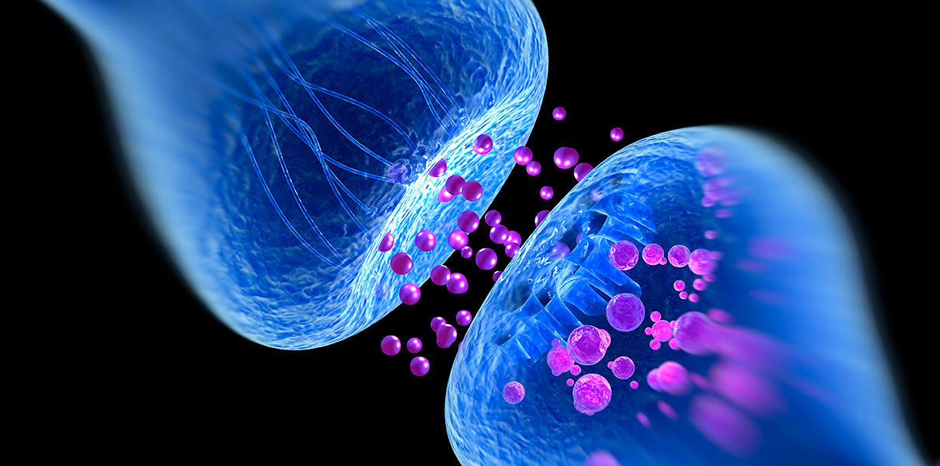
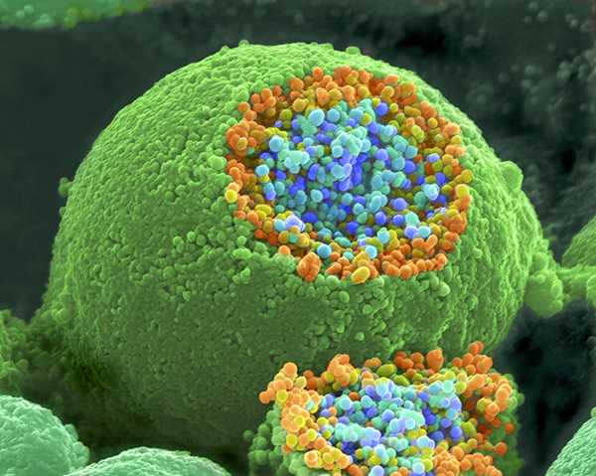
Typical Structure of Neurons
Synapse
Neurotransmitter
Notes:
A typical neuron has an enlarged area, the cell body, which contains the nucleus. Neurons typically also have two types of specialized extensions that project away from the cell body. The branches on which information is received are known as dendrites. Each neuron usually has many dendrites. Each neuron usually also has a longer tail-like structure, or axon, which transmits information to other cells.
Axons can be branched at their tips. The axons of many kinds of neurons are surrounded by a fatty, segmented covering called the myelin sheath. This covering acts as a kind of insulation and improves the ability of axons to carry nervous system signals rapidly. In humans, axons can vary from only a fraction of an inch to more than 3 feet in length! The longest axons extend from the base of the spine all the way to the big toe of each foot.
Neurons communicate with one another through special junctions known as synapses. With the most common type of synapse, known as a chemical synapse, neurons do not actually touch. Rather, the end of the axon (or axon terminal) of one neuron is separated from the next neuron by a tiny gap called a synaptic cleft. Messages traveling from one neuron to the next must cross this gap and bind to the next neuron for the signal to continue along its path. Typically, a single neuron may be capable of receiving messages simultaneously on its dendrites and cell body from several thousand different neurons.
Reference:
From the Brain Chemistry Teacher’s Guide activity, “Neural Network Signals.” Brain Chemistry Teacher’s Guide © Baylor College of Medicine (ISBN: 978-1-888997-45-3) was supported, in part, by funds from the National Institutes of Health, Science Education Partnership Award grant number R25RR13454, and the NIH Blueprint for Neuroscience Research Science Education Award, National Institute on Drug Abuse and NIH Office of the Director, grant number 5R25DA033006.
Image reference:
Illustration © Williams & Wilkins. All rights reserved.

Slide 15



Typical Structure of Neurons
Muscles can get stronger…
Synapses can get stronger…
Notes:
A typical neuron has an enlarged area, the cell body, which contains the nucleus. Neurons typically also have two types of specialized extensions that project away from the cell body. The branches on which information is received are known as dendrites. Each neuron usually has many dendrites. Each neuron usually also has a longer tail-like structure, or axon, which transmits information to other cells.
Axons can be branched at their tips. The axons of many kinds of neurons are surrounded by a fatty, segmented covering called the myelin sheath. This covering acts as a kind of insulation and improves the ability of axons to carry nervous system signals rapidly. In humans, axons can vary from only a fraction of an inch to more than 3 feet in length! The longest axons extend from the base of the spine all the way to the big toe of each foot.
Neurons communicate with one another through special junctions known as synapses. With the most common type of synapse, known as a chemical synapse, neurons do not actually touch. Rather, the end of the axon (or axon terminal) of one neuron is separated from the next neuron by a tiny gap called a synaptic cleft. Messages traveling from one neuron to the next must cross this gap and bind to the next neuron for the signal to continue along its path. Typically, a single neuron may be capable of receiving messages simultaneously on its dendrites and cell body from several thousand different neurons.
Reference:
From the Brain Chemistry Teacher’s Guide activity, “Neural Network Signals.” Brain Chemistry Teacher’s Guide © Baylor College of Medicine (ISBN: 978-1-888997-45-3) was supported, in part, by funds from the National Institutes of Health, Science Education Partnership Award grant number R25RR13454, and the NIH Blueprint for Neuroscience Research Science Education Award, National Institute on Drug Abuse and NIH Office of the Director, grant number 5R25DA033006.
Image reference:
Illustration © Williams & Wilkins. All rights reserved.

Slide 16

Typical Structure of Neurons
Muscles can get stronger…
Synapses can get stronger…
Notes:
A typical neuron has an enlarged area, the cell body, which contains the nucleus. Neurons typically also have two types of specialized extensions that project away from the cell body. The branches on which information is received are known as dendrites. Each neuron usually has many dendrites. Each neuron usually also has a longer tail-like structure, or axon, which transmits information to other cells.
Axons can be branched at their tips. The axons of many kinds of neurons are surrounded by a fatty, segmented covering called the myelin sheath. This covering acts as a kind of insulation and improves the ability of axons to carry nervous system signals rapidly. In humans, axons can vary from only a fraction of an inch to more than 3 feet in length! The longest axons extend from the base of the spine all the way to the big toe of each foot.
Neurons communicate with one another through special junctions known as synapses. With the most common type of synapse, known as a chemical synapse, neurons do not actually touch. Rather, the end of the axon (or axon terminal) of one neuron is separated from the next neuron by a tiny gap called a synaptic cleft. Messages traveling from one neuron to the next must cross this gap and bind to the next neuron for the signal to continue along its path. Typically, a single neuron may be capable of receiving messages simultaneously on its dendrites and cell body from several thousand different neurons.
Reference:
From the Brain Chemistry Teacher’s Guide activity, “Neural Network Signals.” Brain Chemistry Teacher’s Guide © Baylor College of Medicine (ISBN: 978-1-888997-45-3) was supported, in part, by funds from the National Institutes of Health, Science Education Partnership Award grant number R25RR13454, and the NIH Blueprint for Neuroscience Research Science Education Award, National Institute on Drug Abuse and NIH Office of the Director, grant number 5R25DA033006.
Image reference:
Illustration © Williams & Wilkins. All rights reserved.

Slide 17
Typical Structure of Neurons
Muscles can get stronger…
Synapses can get stronger…
Hippocampus
Notes:
A typical neuron has an enlarged area, the cell body, which contains the nucleus. Neurons typically also have two types of specialized extensions that project away from the cell body. The branches on which information is received are known as dendrites. Each neuron usually has many dendrites. Each neuron usually also has a longer tail-like structure, or axon, which transmits information to other cells.
Axons can be branched at their tips. The axons of many kinds of neurons are surrounded by a fatty, segmented covering called the myelin sheath. This covering acts as a kind of insulation and improves the ability of axons to carry nervous system signals rapidly. In humans, axons can vary from only a fraction of an inch to more than 3 feet in length! The longest axons extend from the base of the spine all the way to the big toe of each foot.
Neurons communicate with one another through special junctions known as synapses. With the most common type of synapse, known as a chemical synapse, neurons do not actually touch. Rather, the end of the axon (or axon terminal) of one neuron is separated from the next neuron by a tiny gap called a synaptic cleft. Messages traveling from one neuron to the next must cross this gap and bind to the next neuron for the signal to continue along its path. Typically, a single neuron may be capable of receiving messages simultaneously on its dendrites and cell body from several thousand different neurons.
Reference:
From the Brain Chemistry Teacher’s Guide activity, “Neural Network Signals.” Brain Chemistry Teacher’s Guide © Baylor College of Medicine (ISBN: 978-1-888997-45-3) was supported, in part, by funds from the National Institutes of Health, Science Education Partnership Award grant number R25RR13454, and the NIH Blueprint for Neuroscience Research Science Education Award, National Institute on Drug Abuse and NIH Office of the Director, grant number 5R25DA033006.
Image reference:
Illustration © Williams & Wilkins. All rights reserved.

Slide 18
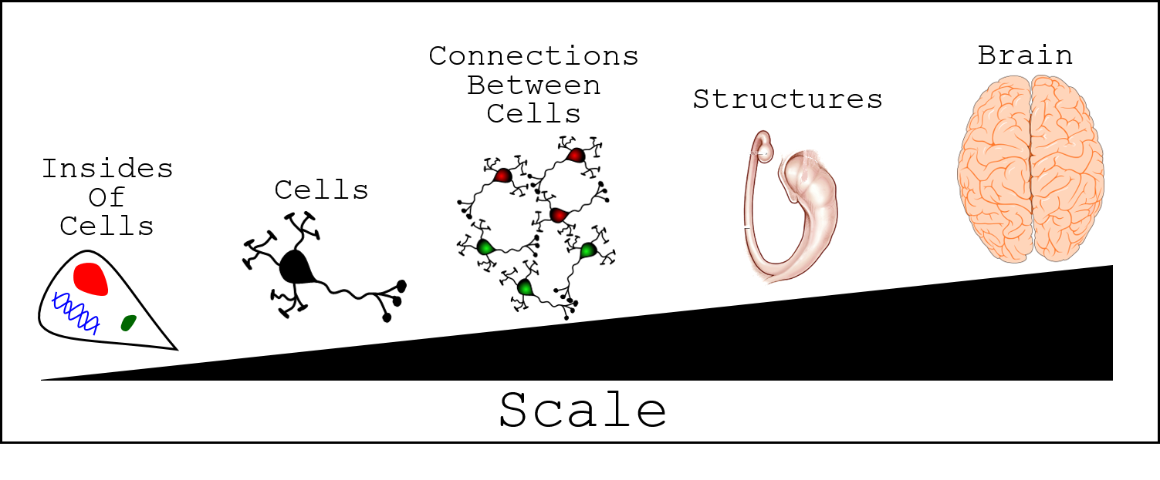
How do many neurons
talk to each other?

Slide 19
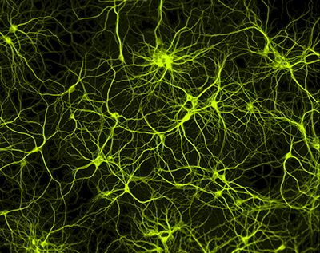
Real Circuit
Thousands of Neurons Connected with Each Other
Notes:
Chemical changes along the length of a neuron's cell membrane cause an electrical charge to move in one direction along the length of the cell's axon. Once the signal reaches the end of the axon, it is passed to the next nerve cell either electrically or by a chemical messenger that crosses the synaptic cleft between nerve cells.
Once the signal reaches the end of the axon (or axon terminal) of a neuron, it must move through the synaptic cleft to the next neuron. At the most common type of synapse, known as a chemical synapse, the impulse triggers the release of chemical messengers, called neurotransmitters, from special pockets known as vesicles.
Reference:
From the Brain Chemistry Teacher’s Guide activity, “Neural Network Signals.” Brain Chemistry Teacher’s Guide © Baylor College of Medicine (ISBN: 978-1-888997-45-3) was supported, in part, by funds from the National Institutes of Health, Science Education Partnership Award grant number R25RR13454, and the NIH Blueprint for Neuroscience Research Science Education Award, National Institute on Drug Abuse and NIH Office of the Director, grant number 5R25DA033006.
Image reference:
Scanning electroni microscope image of a neural network. SEM courtesy of Paul De Koninck, PhD, Laval University. http://www.greenspine.ca/

Slide 20

Flying Through Brain Circuits

Slide 21
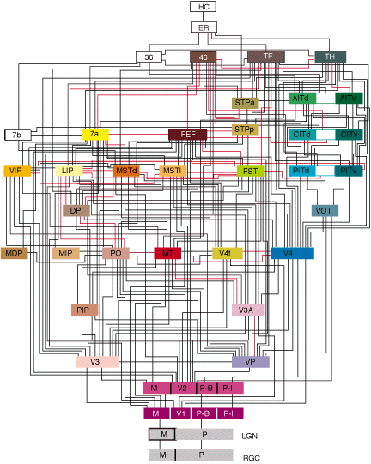
Gets Really Complicated Really Fast

Slide 22
The Brain

Slide 23
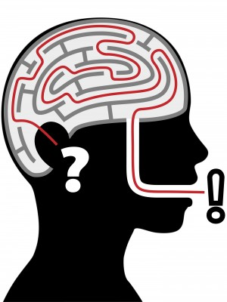
Questions?

Slide 24
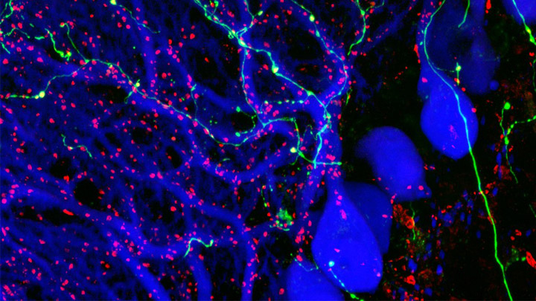
Classroom Slides: Brain Chemistry Teacher’s Guide
Nancy P. Moreno, PhD
Barbara Z. Tharp, MS
Tadzia GrandPré, PhD
Center for Educational Outreach
Baylor College of Medicine
© Mathieu Letellier. CC-BY-NC-ND.
Notes:
From Brain Chemistry Teacher’s Guide: “The Brain”
Did you ever wonder why you can respond so quickly when you are startled? Wonder why you can “see” a picture in your mind’s eye? Wonder why you can remember facts, events and skills that you learned or experienced a long time ago? Your brain and nervous system makes these and many more things possible by controlling virtually all functions of the body by transmitting neurotransmitters via specialized cells, called neurons.
Reference:
Brain Chemistry Teacher’s Guide © Baylor College of Medicine (ISBN: 978-1-888997-45-3) was supported, in part, by funds from the National Institutes of Health, Science Education Partnership Award grant number R25RR13454, and the NIH Blueprint for Neuroscience Research Science Education Award, National Institute on Drug Abuse and NIH Office of the Director, grant number 5R25DA033006.
Image reference:
Purkinje cells (immunofluorescence, blue), olivary axons (anterograde tracing, yellow-green) and synaptic terminals (immunofluorescence, red) are shown, revealing the highly specific organization of neuronal connections in a mouse cerebellum. Image by Mathieu Letellier, Honorable Mention, 2009 Olympus BioScapes Digital Imaging Competition®, http://www.cellimagelibrary.org/images/41920 CC-BY-NC-ND.

Slide 25
Neurotransmitters Contain Chemicals
A scanning electron microscope image of a nerve ending (large, round object). It has been broken open to reveal vesicles containing chemicals (orange and blue) used to pass messages in the nervous system.
Image courtesy of Tina Carvalho, MS, University of Hawai’i.
Notes:
Neurotransmitters (chemical messengers) released from the vesicles of one neuron leave the cell and physically move through a narrow watery space between neurons, called the synaptic gap. This space between the two neurons is about 20 nanometers (one nanometer equals 0.000,000,1 centimeters).
The joining of the neurotransmitters to their specific receptor sites on the receiving neuron can promote the generation of a new electrical impulse (the neuron “fires”) OR the neurotransmitters can have an inhibitory effect, making it harder for the neuron to fire.
Reference:
From the Brain Chemistry Teacher’s Guide activity, “Neurotransmitters Contain Chemicals.” Brain Chemistry Teacher’s Guide © Baylor College of Medicine (ISBN: 978-1-888997-45-3) was supported, in part, by funds from the National Institutes of Health, Science Education Partnership Award grant number R25RR13454, and the NIH Blueprint for Neuroscience Research Science Education Award, National Institute on Drug Abuse and NIH Office of the Director, grant number 5R25DA033006.
Image reference:
SEM image of a nerve ending with its neurotransmitters. SEM courtesy of Tina Carvalho, MS, University of Hawai’i (released to public domain). http://www.cellimagelibrary.org/images/214

Slide 26
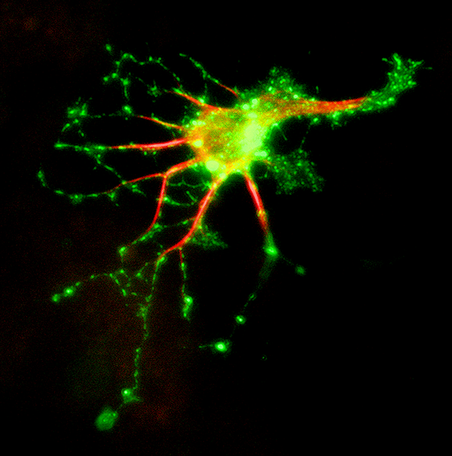
Neurons Have Specialized Receptors
Microscopic image of a single neuron stained to reveal receptor sites for a specific chemical.
Image © Baylor College of Medicine\Robert S. McNeil.
Notes:
Biologists have identified more than 100 different neurotransmitters. Each has a different three-dimensional shape, which fits only a certain kind of receptor site. The relationship between a neurotransmitter and its receptor is similar to that of a key and a lock.
Reference:
From the Brain Chemistry Teacher’s Guide activity, “Neurotransmitters Contain Chemicals.” Brain Chemistry Teacher’s Guide © Baylor College of Medicine (ISBN: 978-1-888997-45-3) was supported, in part, by funds from the National Institutes of Health, Science Education Partnership Award grant number R25RR13454, and the NIH Blueprint for Neuroscience Research Science Education Award, National Institute on Drug Abuse and NIH Office of the Director, grant number 5R25DA033006.
Image reference:
Microscopic image of a hippocampal neuron © Baylor College of Medicine\Robert S. McNeil. http://www.neuralimages.org/

Slide 27
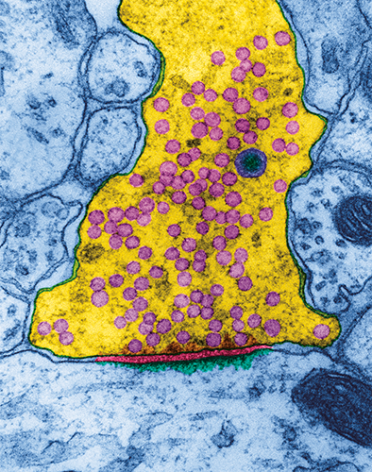
Crossing the Synaptic Gap
This microscopic image has been modified to reveal the synaptic cleft between the axon of a nerve cell in the hippocampus (part of the limbic system needed for memory) and a receiving neuron.
Vesicles (small, circular pink objects) release neurotransmitters into the synaptic cleft.
Transmitting Neuron
Synaptic Gap
Receiving Neuron
TEM image © Dennis Kunkel Microscopy, Inc.
Notes:
Most neurons in the brain communicate with each other by releasing chemical messengers called neurotransmitters. Neurotransmitters cross the gaps between neurons or between neurons and other cells, such as muscle, and match up with specific receptors. Chemical signaling between neurons allows different kinds of messages to be sent. For example, some chemical messengers stimulate neurons to fire, while other messengers make it harder for an electrical impulse to be generated in the receiving neuron. Since one neuron can share synapses with thousands of other neurons, the combined effects of different messages ultimately determine whether a signal will be triggered or not.
Many drugs interfere with communication between nerve cells. Some drugs act directly on neurons, neurotransmitters and receptors. Curare, for example, is a deadly poison used by South American Indians. It causes death from paralysis by blocking receptors on muscle cells. Since the receptors are blocked, the real chemical messenger for muscle contraction (acetylcholine) can no longer stimulate the muscles to contract.
Drugs also can interfere with communication between neurons in other ways, such as by preventing the manufacture or release of neurotransmitters, by causing excessive firing of neurons by stimulating massive releases of neurotransmitters, by mimicking the effects of chemical messengers, or by preventing the normal breakdown and recycling of chemical messengers.
Reference:
From the Brain Chemistry Teacher’s Guide activity, “Crossing the Synaptic Gap.” Brain Chemistry Teacher’s Guide © Baylor College of Medicine (ISBN: 978-1-888997-45-3) was supported, in part, by funds from the National Institutes of Health, Science Education Partnership Award grant number R25RR13454, and the NIH Blueprint for Neuroscience Research Science Education Award, National Institute on Drug Abuse and NIH Office of the Director, grant number 5R25DA033006.
Image reference:
Transmission electron microscopic image of the synaptic gap between two neurons. TEM image © Dennis Kunkel Microscopy, Inc. http://education.denniskunkel.com/catalog/home.php

Slide 28
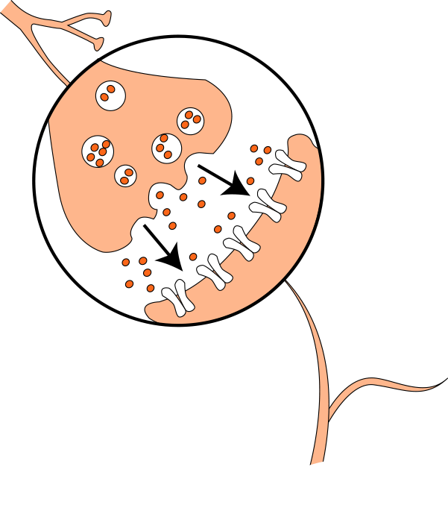
Chemical Communication
In most cases, communication across the synapse occurs chemically instead of electrically.
Neurotransmitters can either promote or inhibit the firing of receiving neurons.
Illustration © Baylor College of Medicine\M.S. Young.
Notes:
Each of the billions of neurons in the nervous system communicate with one another and with other cells, such as muscle cells, through special junctions known as synapses. Some neurons share synapses with thousands of other cells. Others connect with only a few cells.
In some cases, instead of binding to the receiving neuron, neurotransmitters simply float (diffuse) away from the synapse. Other neurotransmitters are broken down or degraded by enzymes found within the synaptic cleft. Many neurotransmitters are transported, whole, back into the neuron that released them. Some drugs, such as cocaine and fluoxetine (Prozac®), exert their effects by interfering with the removal of neurotransmitters from the synapse.
Sometimes, neurons do not communicate through neurotransmitters. Instead, an electrical charge passes directly from neuron to neuron through what is known as an electrical synapse. This type of signaling, in which the communicating neurons are very close together, is very fast and allows many interconnected neurons to fire at the same time. Electrical synapses are less common than chemical synapses, but they are very important for the normal development and function of the nervous system.
Reference:
From the Brain Chemistry Teacher’s Guide activity, “Neurotransmitters Contain Chemicals.” Brain Chemistry Teacher’s Guide © Baylor College of Medicine (ISBN: 978-1-888997-45-3) was supported, in part, by funds from the National Institutes of Health, Science Education Partnership Award grant number R25RR13454, and the NIH Blueprint for Neuroscience Research Science Education Award, National Institute on Drug Abuse and NIH Office of the Director, grant number 5R25DA033006.
Image reference:
Illustration © Baylor College of Medicine\M.S. Young. http://www.bcm.edu/

Slide 29
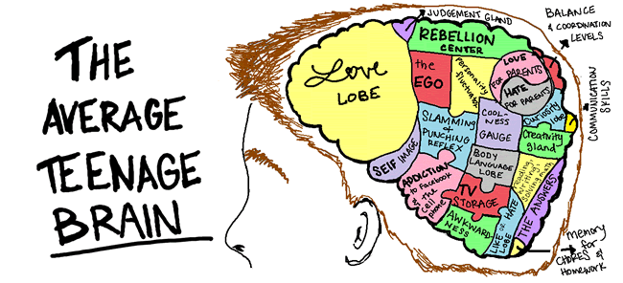
The Teenage Brain!!!!!
http://iesin-3eso.blogspot.com/2015/04/adolescent-brain-development.html

Slide 30
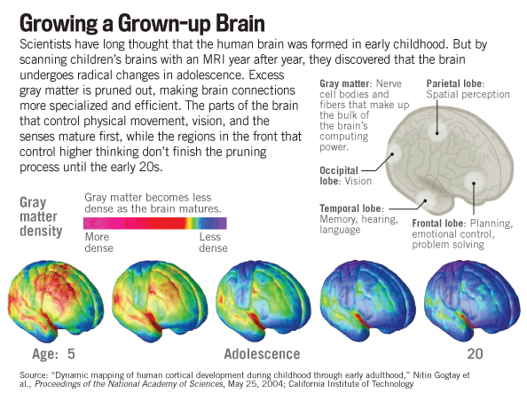
The Teenage Brain!!!!!

Slide 31
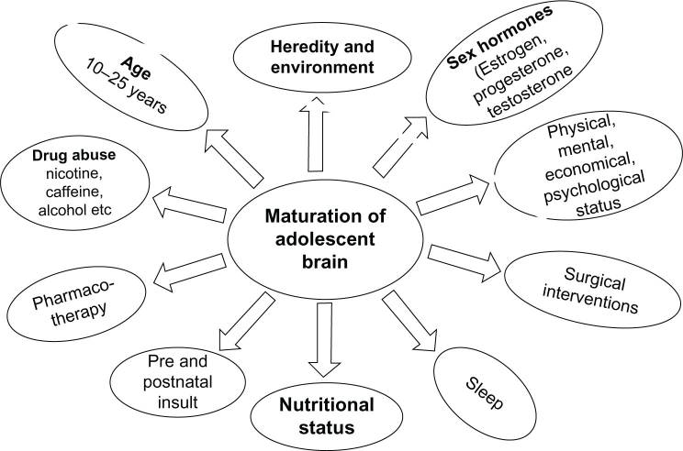
The Teenage Brain!!!!!

Slide 32
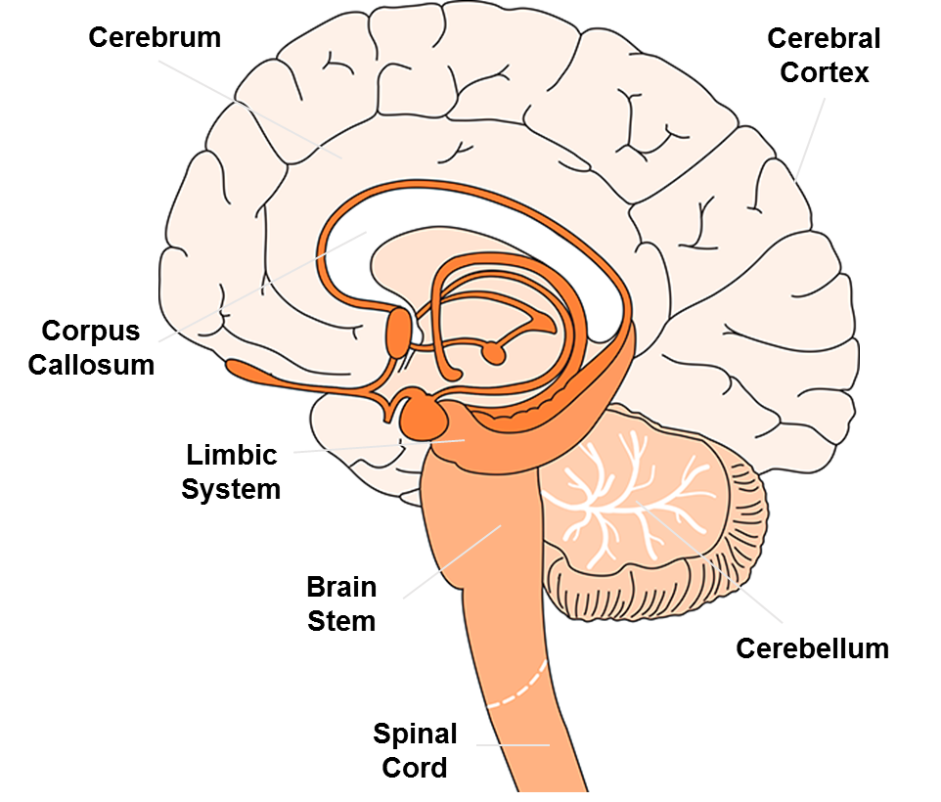
The Teenage Brain!!!!!

Slide 33
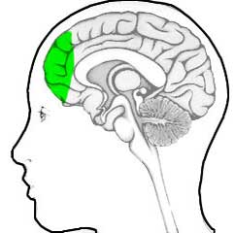
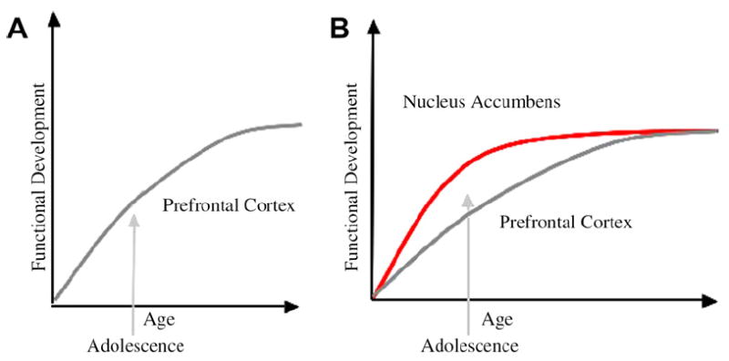
Prefrontal Cortex
Judgement
Rational Thought
Goal-oriented
Casey et al., Dev. Rev. (2008)

Slide 34
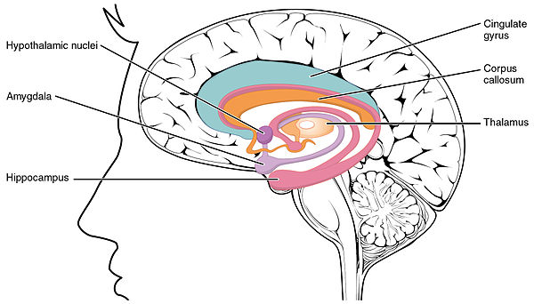
Limbic System
Fear, Anxiety, Stress
Pleasure & Reward
Memory and Emotional Response

Slide 35
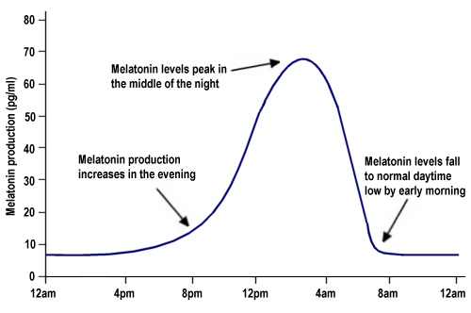

Sleep ZZZZZ
Circadian rhythm is shifted
Start secreting Melatonin later at night.
Teens need at least 8.5-9.5 hrs. sleep per night.

Slide 36
Sleep ZZZZZ
70% reported getting less than 8.5 hrs of sleep per night.
58-68% reported being “really sleepy” between 8 and 10 a.m.
Percentage of students who
feel “really sleepy” at different
times of day
Gibson et al. (2006)

Slide 37
Sleep ZZZZZ
The reaction times of adolescents are much better in the afternoon than they are in the morning (lower means better)!
And that students perform better in the afternoon than in the morning.
Hansen et al. (2005)

Slide 38
Addiction
Both behaviors are associated with activation of the limbic system.
Activation of the brain reward
System causes us to feel a sense of pleasure.
Many abused drugs act of structures of the limbic system to create the same feelings of pleasure/rewards as brain neurotransmitters
Addiction can permanently alter the structure of the brain

Slide 39
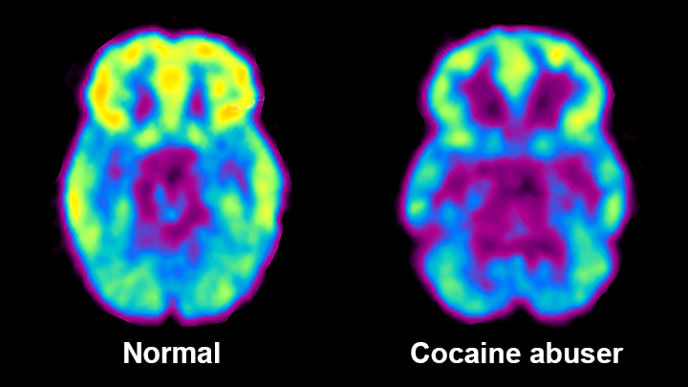
Addiction
Drug addiction compromises the brain circuits involved in processing reward and punishment, and in exerting control over one’s actions.
This set of PET scans shows what happens in the brain when drugs are abused.
On the left is a scan of a normal brain. Notice the bright areas of activity. The scan on the right is of a person who is abusing cocaine. The large dark areas show the loss of neuronal activity. This loss can be reversed if an abuser stops taking the drug.
MRI image courtesy of NIDA.
Notes:
It is important to note that most people begin to use brain-altering chemicals voluntarily. Over time, however, the brain and body may adapt to the effects of a chemical. This can create a new “normal” state, adjusted to the presence of the introduced substance. This adaptation may lead to a physical dependence on the substance, such that the individual requires the chemical to function normally.
For example, more than 80 percent of the current US population chooses to consume the stimulant caffeine in coffee and/or cola drinks because of its taste and/or perceived enhancement of mental and physical performance. Eventually, most caffeine consumers develop a dependence on its stimulating effects and experience mild withdrawal symptoms, such as sleepiness and headaches, when they do not have caffeine.
Other chemicals have more dramatic effects on the brain and body, affecting the brain’s natural reward centers, which are responsible for generating feelings of pleasure or well-being. However, feelings of euphoria, comfort or pleasure often decrease or disappear after the first few uses of the substance.
Drugs that act on areas of the brain related to sensations of pleasure are sometimes used inappropriately by people. Unfortunately, continued drug use actually changes the way the brain works. In some cases, it can cause permanent changes in the structure and function of the brain. This is the biological basis of addiction.
Many mind-altering chemicals abused by children and adults in the US lead to permanent changes in the brain that lead to addiction, and also may cause damage to other parts of the body.
Marijuana use can alter memory regions of the brain and affect coordination and the senses in the short term.
Heroin changes the way nerve cells in the brain receive and process messages.
Inhalants, which are taken up by fatty tissue in the body, damage or destroy the fat-containing myelin sheath on nerve cell axons and disrupt nervous system communications, sometimes permanently.
LSD can contribute to the development of chronic mental disorders.
Alcohol, which depresses physical and mental abilities, damages many tissues throughout the body, including the liver and the brain. Alcohol also is a major contributing factor to automobile accidents because it affects coordination and judgment.
Nicotine, a stimulant in tobacco, is a very addictive substance that can damage the circulatory system. However, the greatest health risk from smoking comes from other compounds in cigarette and cigar smoke that are linked to development of lung and other cancers. Nicotine is one of the most addictive substances in common use.
Reference:
From the Brain Chemistry Teacher’s Guide activity, “Drugs, Risks and the Nervous System.” Brain Chemistry Teacher’s Guide © Baylor College of Medicine (ISBN: 978-1-888997-45-3) was supported, in part, by funds from the National Institutes of Health, Science Education Partnership Award grant number R25RR13454, and the NIH Blueprint for Neuroscience Research Science Education Award, National Institute on Drug Abuse and NIH Office of the Director, grant number 5R25DA033006.
Image reference:
MRI image courtesy of NIDA. http://www.drugabuse.gov/publications/science-addiction/drug-abuse-addiction

Slide 40
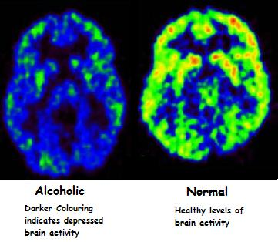
Addiction

Slide 41
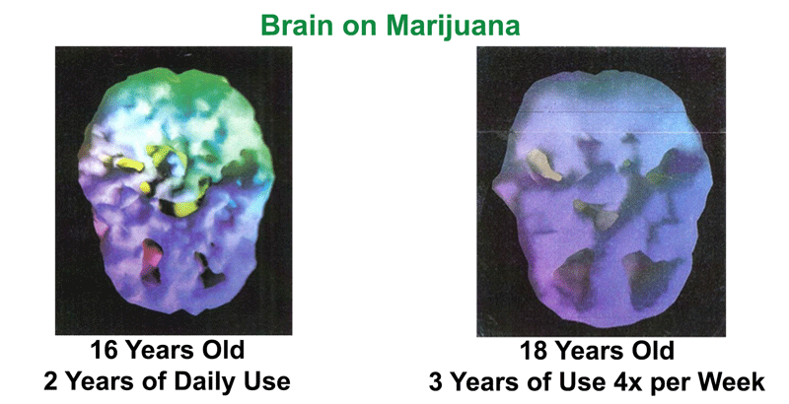
Addiction
Can decrease your IQ by up to 8 points!!!!

